Slide 1
Applications of Chatbot
Presented By: Chhaya Hemangi K.
Roll No:04
Reg.No:06-0245-2017
Sem.: 7th
Guided By: Dr.Y.R.Ghodasara

Slide 2
Introduction
Title | Platform | Use NLP
Corona Virus Information Chatbot | Snatchbot | Yes
2. Government Exam Chatbot | Snatchbot | No
3. E-Commerce | Chatteron | No
4. College Enquiry Chatbot | FlowXo | No
5. Latest News Feeder Chatbot | FlowXo | No

Slide 3
Corona Virus Information Chatbot
This Chatbot is providing all corona virus information of users query. In the context of chatbots, integrating NLP means adding a more human touch. If you've built a chatbot and deployed it for public use, it's likely that you've seen users attempting to ask it questions. This chatbot will help you to track important information about Corona virus (2020), including latest news, precautions and FAQ in Guajarati language.

Slide 4
Government Exam Chatbot
This Chatbot is providing all Government Exam information of users query. Users choose start button click then starting the quiz. This chatbot template asks questions, keeps score of whether the answers are right or wrong and gives the result and feedback at the end.
E-Commerce
This bot provide all product with images, all product details provide the users and buy now clicking button then go to the website page and than buy now the product. This chatbot make in Chatterton platform and I have used in entity. To user write have show this product to then direct this page show the users.

Slide 5
College Enquiry Chatbot
College Enquiry Chatbot provides to all information Educational templates to kids through chatbots. To all students show the college information, course details and contact the college details. Student enter merit then check the condition then show the college.
Latest News Feeder Chatbot
This chatbot provide the different language and different sources. To provide the latest news in newspaper links, images and videos to show the all users. Then clicked more information provide to bot and end the chat.

Slide 6
Objectives
To study different chatbot applications for different sectors.
The objective of chatbots is to support and scale business teams in their relations with customers.

Slide 7
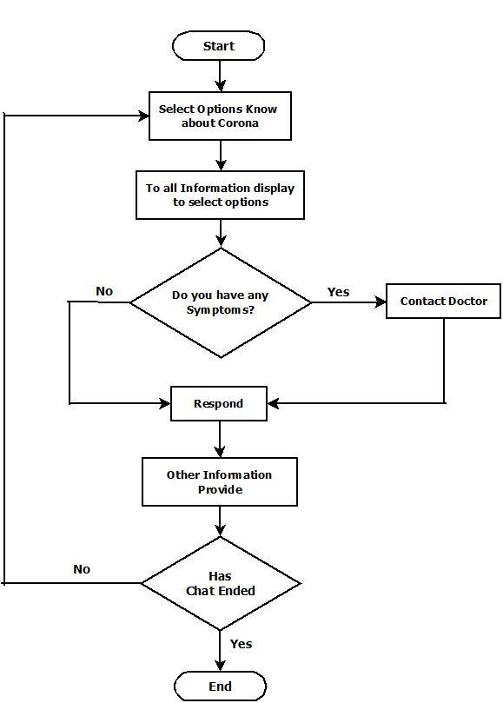
Flowchart Diagram
Corona virus Information Chatbot

Slide 8
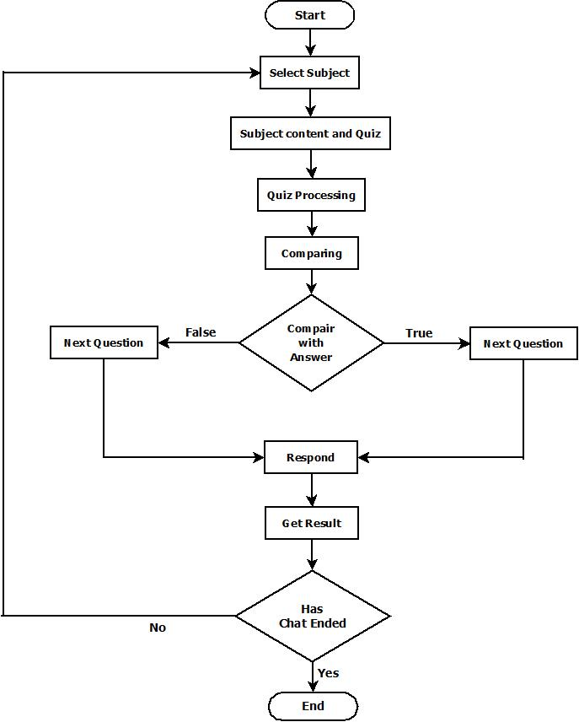
Government Exam Chatbot

Slide 9
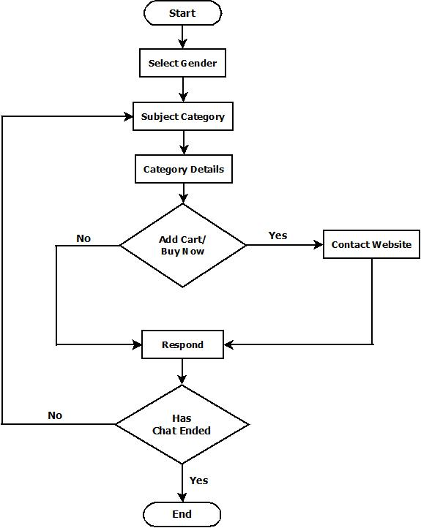
E-Commerce

Slide 10
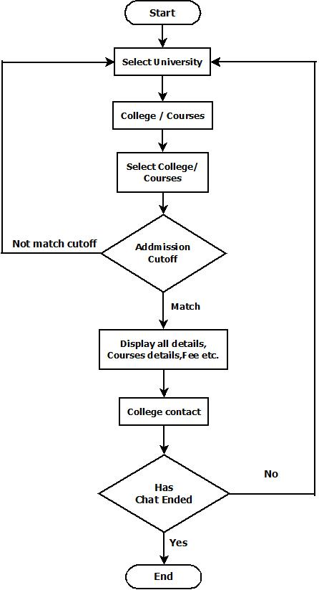
College Enquiry Chatbot

Slide 11
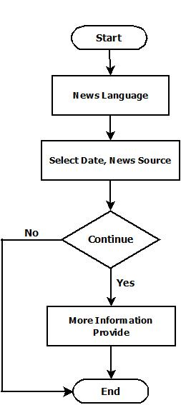
Latest News Feeder Chatbot

Slide 12
Conclusion
This work introduced the fundamentals of what chatbots are. It gave an overview about ideas, products and platforms, both, from the past and available today. The current interests in chatbots, potential use cases and limitations have been explored in detail. Different aspects of the implementation of a chatbot and working with conversational interfaces have been presented through the creation of an exemplary chatbot, which included interaction and user experience design, and general, reusable software architecture for chatbots.

Slide 13
Thank You

